Slide 1

AI-Powered Learning Platform
Transforming education through intelligent, personalised roadmaps built with the MERN Stack

Slide 2

The Learning Challenge
Unstructured Learning Holds Students Back
Many aspiring developers face overwhelming choices when starting their learning journey. Without clear direction, they struggle to prioritise topics, allocate time effectively, and find quality resources.
This platform solves these challenges by providing AI-generated, personalised learning paths that adapt to individual goals, skill levels, and schedules.

Slide 3




Platform Overview
AI-Powered Roadmaps
Predefined Paths
Generate custom learning plans using Gemini AI based on your chosen language and timeframe
Ready-made roadmaps for JavaScript, Python, React, Node.js, MongoDB, and more
User-Friendly Design
Dynamic Data Management
Built with React for smooth navigation and an exceptional learning experience
Express.js and MongoDB backend ensures efficient, scalable performance

Slide 4

Project Goals and Objectives
01
02
Structured Learning
Personalization
Provide clear, organized paths that eliminate confusion and guide learners step-by-step
Deliver AI-driven customisation based on individual skill levels, goals, and available time
03
04
Engagement
Practical Skills
Foster motivation through gamification, progress tracking, and community collaboration
Encourage hands-on learning with mini projects, quizzes, and real-world challenges

Slide 5

Technology Stack
MongoDB
Express.js
Flexible NoSQL database for storing user data, roadmaps, and progress tracking
Backend framework handling API requests, authentication, and business logic
React
Node.js
Dynamic frontend library creating responsive, interactive user interfaces
JavaScript runtime powering the server-side application and API integration
Gemini AI
Google's advanced AI model generating intelligent, context-aware learning roadmaps

Slide 6
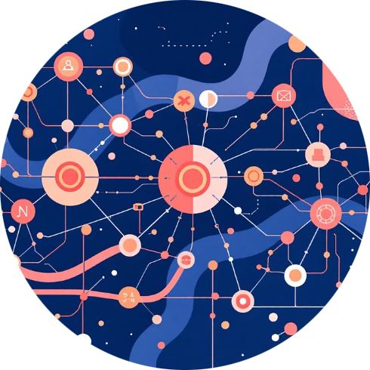



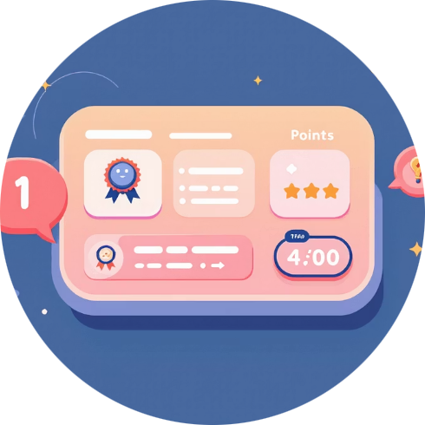

Core Features and Team Responsibilities
AI Learning Path Generator
Resource Recommendations Engine
AI Mentor Chatbot
Learning Analytics Dashboard
Vaishnavi • Integration with MERN and Gemini API • User input to roadmap output process
Akhil • Purpose and user benefits • Curated learning materials matched to roadmap topics
Venkat • MERN chat API • Chatbot capabilities for explanations and coding examples
Nithin • Progress tracking • Insights into strengths, weaknesses, and time management
Gamified Learning Engine
Community Collaboration
Bilwa • Points, badges, and rewards system • Making learning enjoyable and motivating
Dileep • AI and ML tools • Discussion forum for peer learning and knowledge sharing

Slide 7
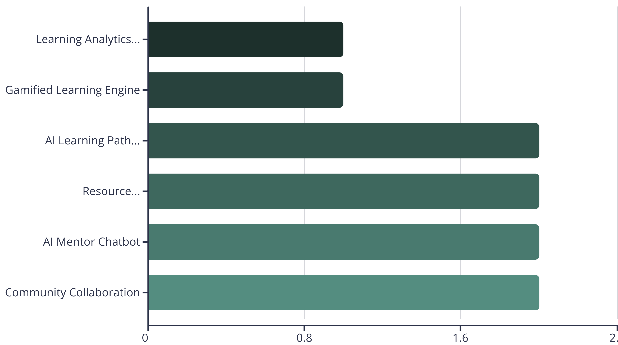
Implementation Roadmap
Six key features ranked by complexity and feasibility, designed for rapid development and deployment
All features leverage the MERN Stack foundation with strategic API integrations including Gemini AI, Chart.js, and Socket.io for real-time collaboration.

Slide 8




What Makes This Platform Unique
AI Personalization
Integrated Experience
Continuous Adaptation
Unlike static learning sites, our platform adapts dynamically to each learner's progress and needs
Combines structured roadmaps, intelligent assistance, and gamified tracking in one cohesive platform
The AI learns from user behaviour, automatically adjusting difficulty and pacing for optimal learning

Slide 9






Future Enhancements
Adaptive AI Learning
Enhanced Gamification
System tracks progress and automatically adjusts roadmaps based on performance patterns
Expanded points, badges, and learning streak rewards to maintain motivation
Career Mode
Mini Projects and Quizzes
Role-specific roadmaps for positions like Frontend Developer, Data Analyst, or Full-Stack Engineer
Hands-on coding challenges and assessments to test and strengthen understanding
Smart Resource System
Advanced Analytics
AI suggests high-quality tutorials, documentation, and articles tailored to each topic
Deep insights into learning patterns, time allocation, and personalized improvement recommendations

Slide 10

Transforming Learning Through Innovation
This platform revolutionizes how aspiring developers learn by providing clear, customized, and engaging experiences.
By combining AI-generated roadmaps, real-time progress tracking, gamification, and community support, we empower learners to build practical skills with consistency and confidence.
The future of learning is intelligent, adaptive, and student-centered.
S

